Slide 1
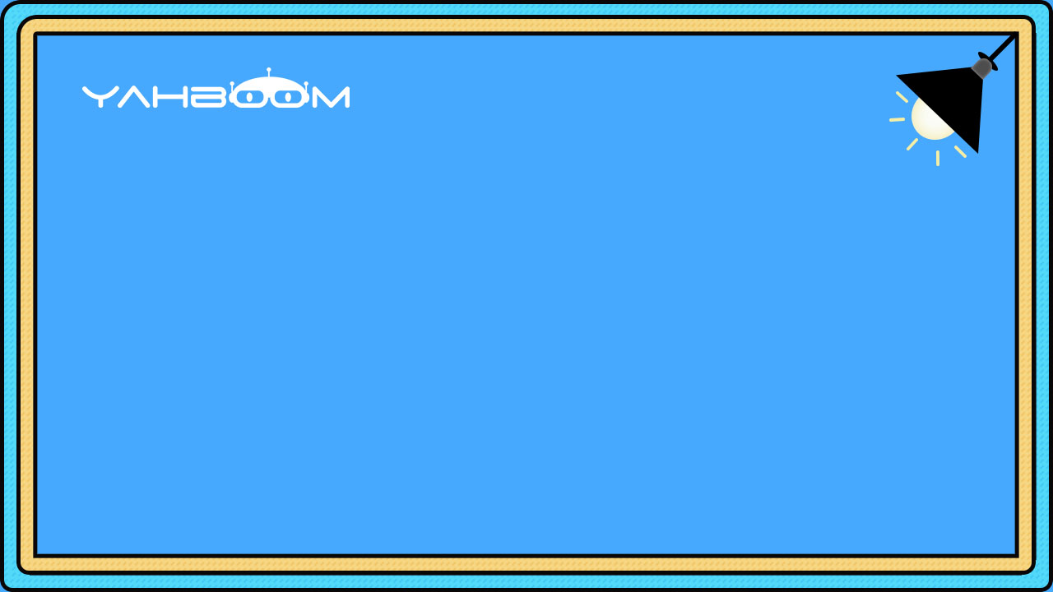

micro:bit programming tutorial
Lesson 17
micro:bit basic lesson 17 "Seismograph"
Yahboom micro:bit tutorial

Slide 2
micro:bit programming tutorial
Part1
Part 2
Part3
Part 4
Part 5
Learning goals
Preparation
Search for blocks
Combine blocks
Have a try
Yahboom micro:bit tutorial

Slide 3
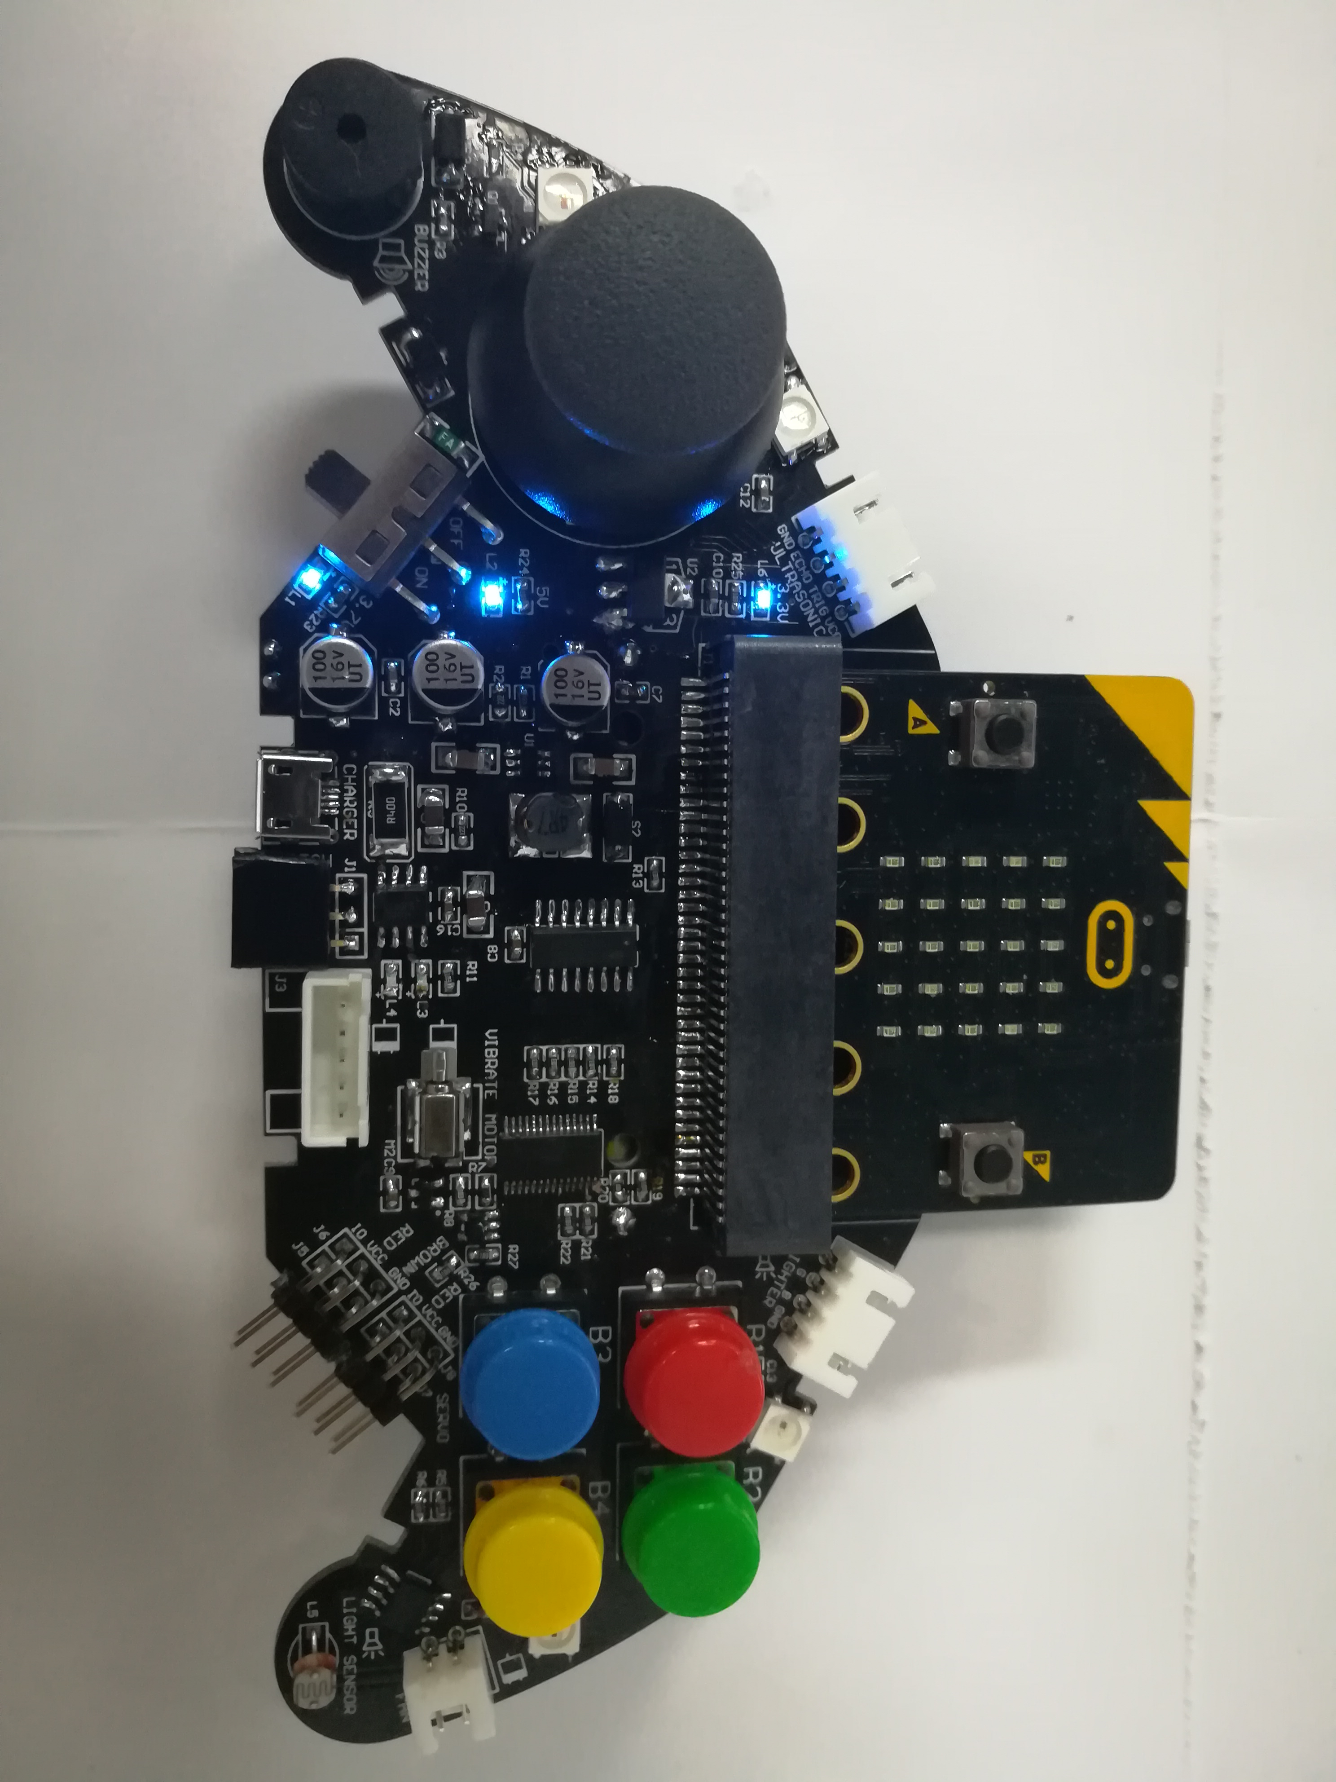
micro:bit programming tutorial
Part1
When the program is downloaded,,shake the handle and the handle will vibrate!
Yahboom micro:bit tutorial

Slide 4
micro:bit programming tutorial
Part2
Hardware：
● 1 X micro:bit Game Handle
● 1 X Micro USB Cable
Yahboom micro:bit tutorial

Slide 5
micro:bit programming tutorial
Two programming methods
Part2
1.Online: Connect Micro:bit to the computer via USB cable, and the computer will pop up a U disk and click the URL in the U disk to enter the programming interface.Enter this URL https://github.com/yahboomtechnology/ghbitlib to get the package named GHBit.
2.offline：Open micro:bit offline programming software and add GHBit package.Click on "Advanced" and select "Add Package".Enter this URL https://github.com/yahboomtechnology/ghbitlib to get the package named GHBit.
Note: If you already have a GHBit package, you don't need to add it repeatedly.
Yahboom micro:bit tutorial

Slide 6
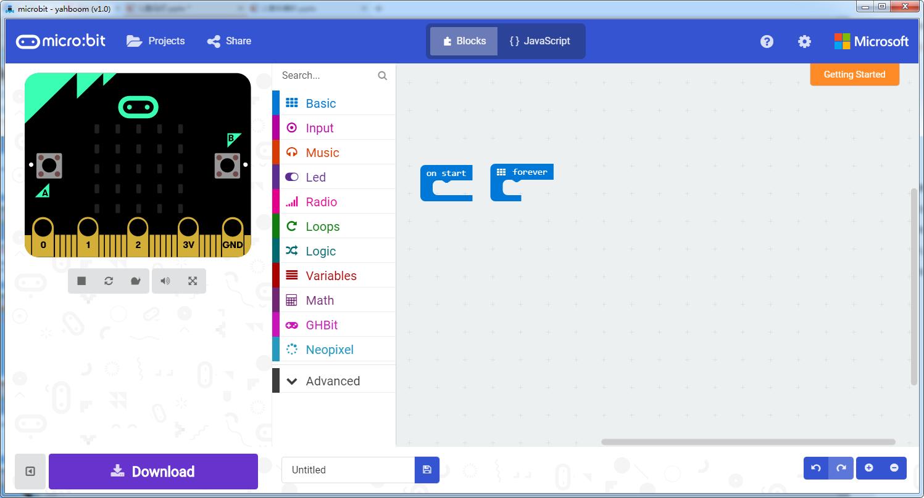
micro:bit programming tutorial
Programming interface
Part3
Yahboom micro:bit tutorial

Slide 7
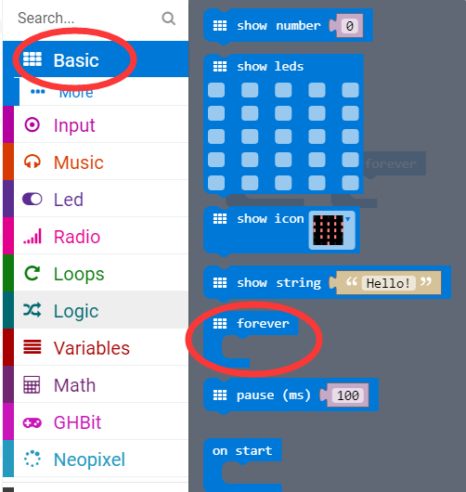
micro:bit programming tutorial
Part3
Start programming
The “forever” building block means that when the micro:bi Game Handle is turned on, the blocks in “forever” are repeatedly executed.
Yahboom micro:bit tutorial

Slide 8
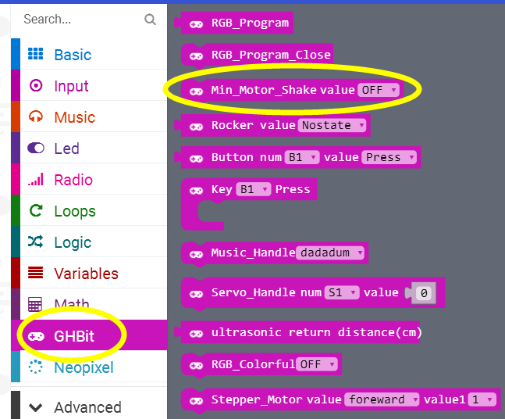
micro:bit programming tutorial
Part3
Control vibration switch.
Yahboom micro:bit tutorial

Slide 9
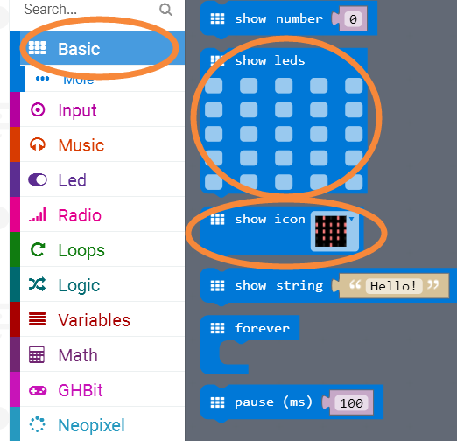
micro:bit programming tutorial
Part3
Draws an image on LED screen.
And draws the selected icon on the LED screen.
Yahboom micro:bit tutorial

Slide 10
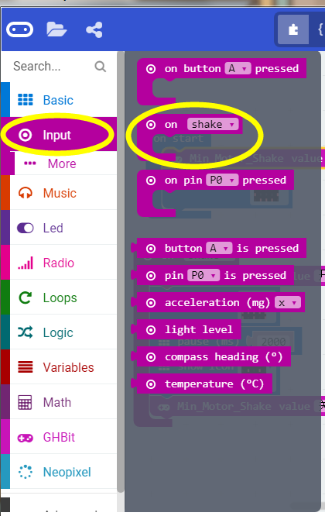
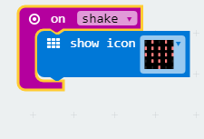
micro:bit programming tutorial
Part3
This building block is similar to the choice of building blocks!
E.g
When the handle is shaken, the LED screen will display a red heart.
Yahboom micro:bit tutorial

Slide 11
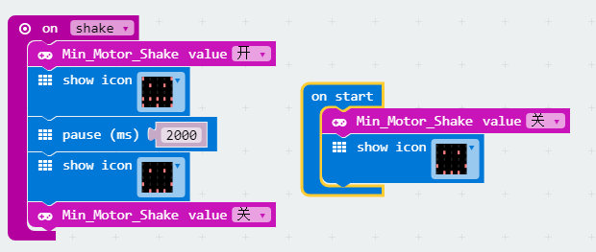
micro:bit programming tutorial
Part4
This is the complete building block for this course, let's download it to the micro:bit Game Handle.
Yahboom micro:bit tutorial

Slide 12
micro:bit programming tutorial
Part5
Do you learn the course today?
If you learn to do it, give yourself a top quack.
Now give you a homework assignment.
Write a program to play a song when shaking the handle.
Start your little brain. Try it.
Yahboom micro:bit tutorial

Slide 13
micro:bit programming tutorial
micro:bit
Thanks for watching！
Yahboom
Yahboom micro:bit tutorial

